Slide 1
Clonal reconstruction of cancer from the single-cell expression based CNV inferences
M.Tech Thesis Defense
Supervisor,
Prof. Debarka Sengupta
Presented by,
Kiran Sethi
MT20211

Slide 2
Research Objectives
Objective 1- Clonal reconstruction of cancer from single cell expression
based CNV inferences.
Objective 2: Development of an end to end transfer learning based web server for single cell analysis (tranSCend)

Slide 3
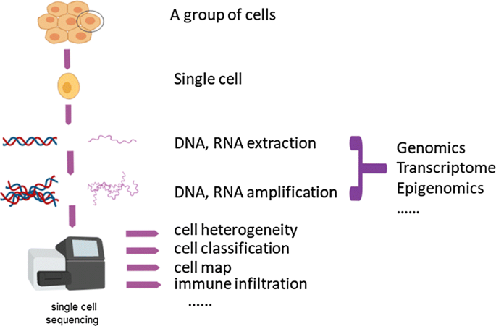
What is Single cell RNA sequencing ?
Source:https://cellandbioscience.biomedcentral.com/articles/10.1186/s13578-019-0314-y

Slide 4
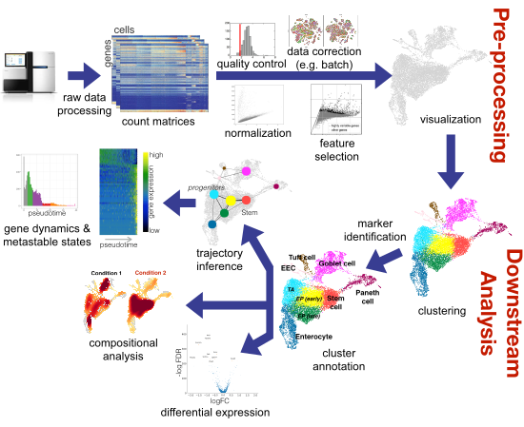
scRNA-seq: Complete Overview

Slide 5
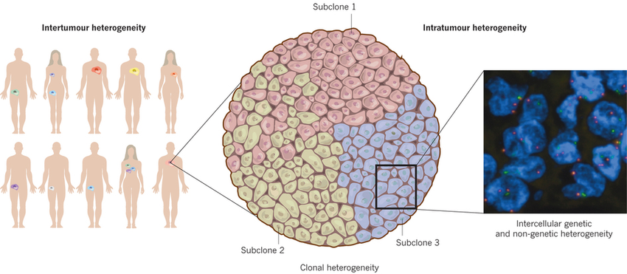
Intra Tumor Heterogeneity : An Introduction
Intratumor heterogeneity ,also known as intralesional heterogeneity refers to distinct tumor cell populations (with different molecular and phenotypic profiles) within the same tumor specimen.

Slide 6
Tumor Heterogeneity : Broad View
.
Intertumour Heterogeneity , Intra tumour heterogeneity and Intercellular Heterogeneity

Slide 7
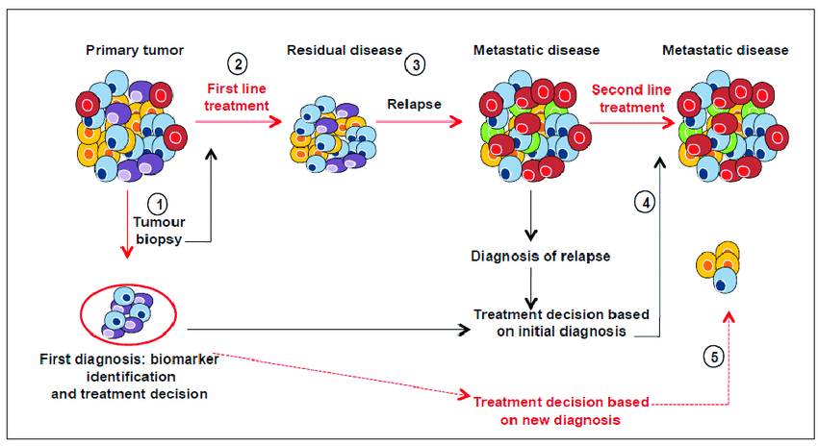
Effects of Intra tumor heterogeneity on the predictive value of biomarkers
Intra-tumor heterogeneity: a big PROBLEM!
Source:https://www.researchgate.net/figure/Effects-of-tumour-heterogeneity-on-the-predictive-value-of-biomarkers-Cancer-diagnosis

Slide 8
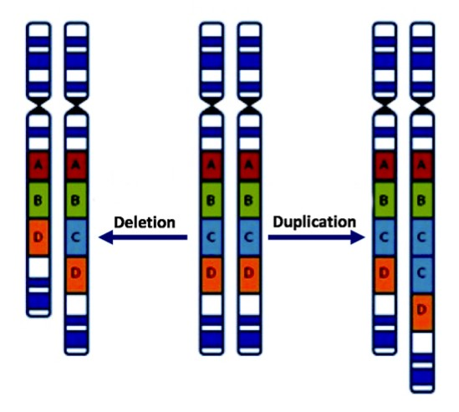
Copy Number Variation
A copy number variation (CNV) is when the number of copies of a particular gene varies from one individual to the next.It is a type of structural variation where we have a stretch of DNA, which is duplicated in some people, and sometimes even triplicated or quadruplicate.
And so when we look at that chromosomal region, we will see a variation in the number of copies in normal people.
.

Slide 9
InferCNV: A tool to generate CNV profile from scRNA
InferCNV is used to explore tumor single cell RNA-Seq data to identify evidence for somatic large-scale chromosomal copy number alterations, such as gains or deletions of entire chromosomes or large segments of chromosomes.
This is done by exploring expression intensity of genes across positions of tumor genome in comparison to a set of reference 'normal' cells.
.

Slide 10
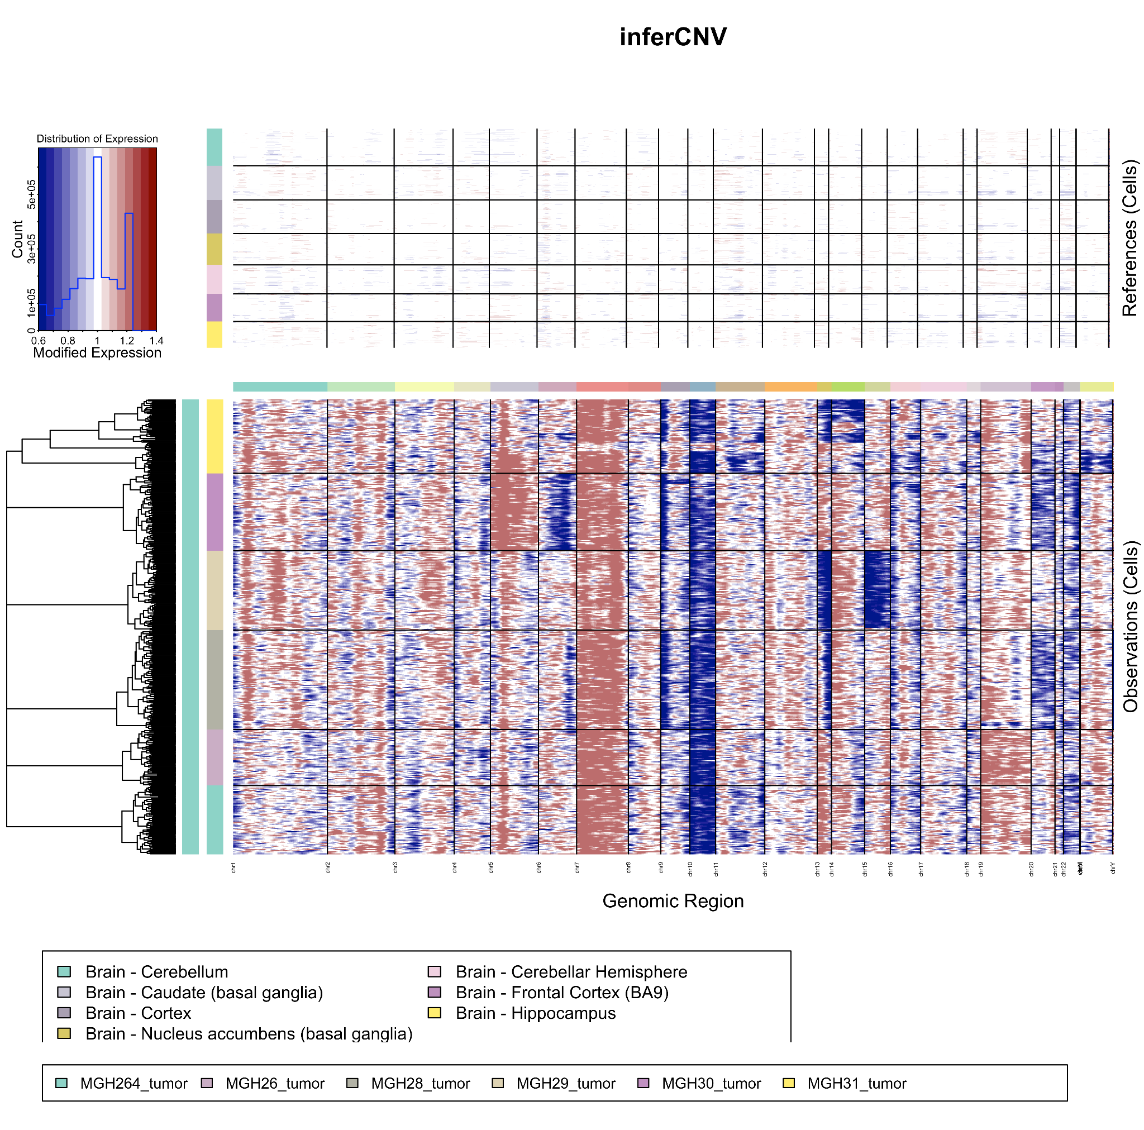
InferCNV generated heatmap corresponding to the Copy Number Variation Profile for glioblastoma tumour

Slide 11
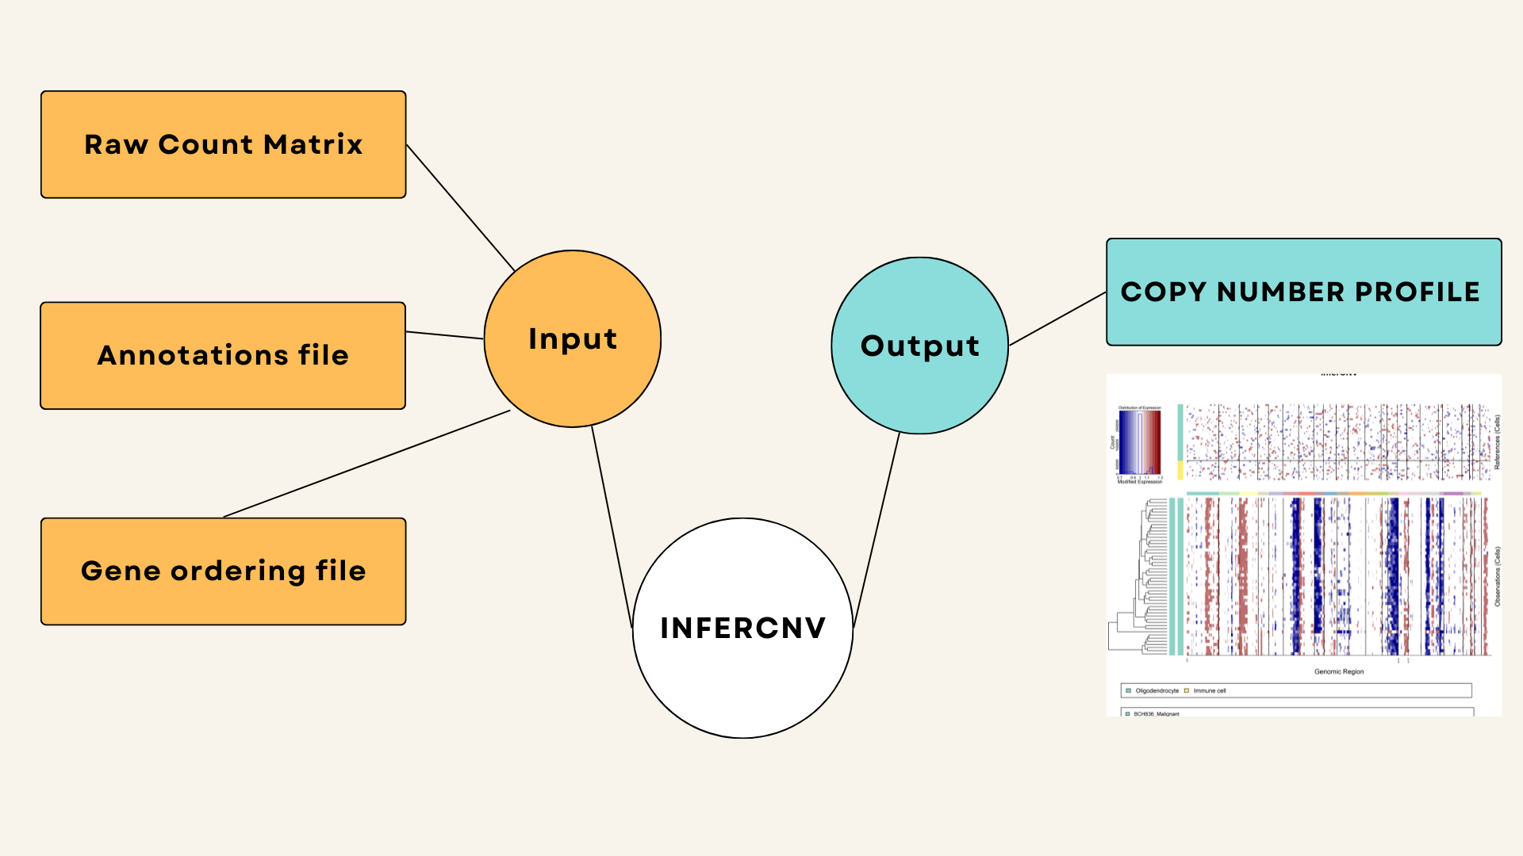
An overview of InferCNV

Slide 12
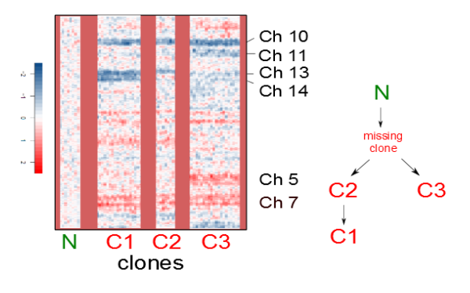
Related work and Background
Patel et Al result has shown that transcriptional heterogeneity is resulted from clonal heterogeneity.
Analysis of glioblastoma , for patient MGH31 and expected clonal phylogeny from the visual inspection.
N=reference cells /normal cells

Slide 13
Part1. Clonal Reconstruction of cancer
The previous slide has shown the expected clonal phylogeny w.r.t visual inspection.
Can we create mathematically and computationally rigorous framework for modelling clonal phylogeny at single cell resolution using single cell RNAseq data ?

Slide 14
Tumor Dataset Details
Tumor name- pediatric midline gliomas
Data Source- https://portals.broadinstitute.org/single_cell/study
Patient- BCH836
.

Slide 15
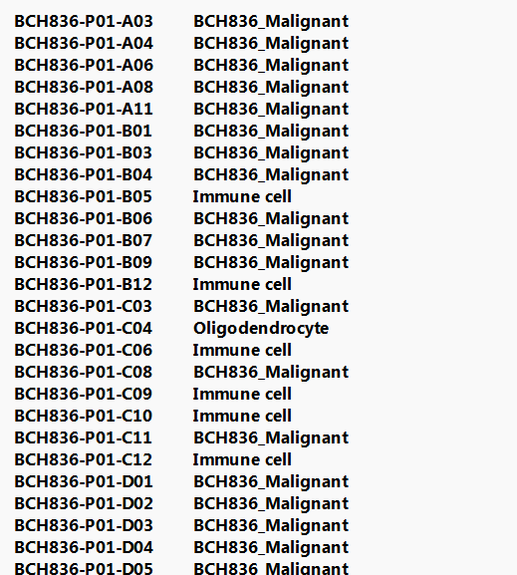
Step 1: Create Annotation file patient wise
First column = cell name
Second column = cell type
Patient id can be observed from the cell name
Only patient of interest is kept in the annotation file i.e BCH836 to generate patient wise CNV
Notes:
## add snapshot of the annotation file

Slide 16
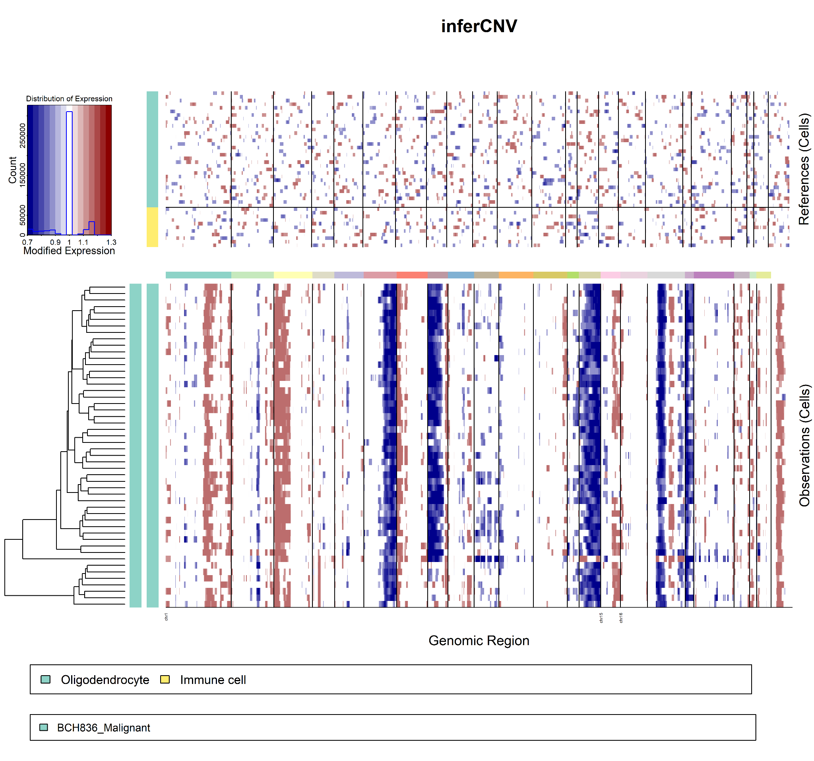
Step2. Generate Copy Number profile using InferCNV
Heatmap for Copy Number Profile of the patient BCH836 generated using inferCNV.
Observations correspond to residual expression of malignant cells while references correspond to the non malignant cells.
Notes:
# add infercnv heatmap corresponding to BC6H1126 patient , tell we also get the matrix corresponding to the profile

Slide 17
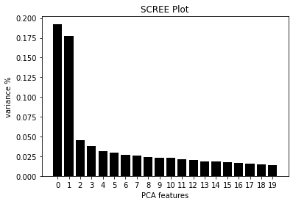
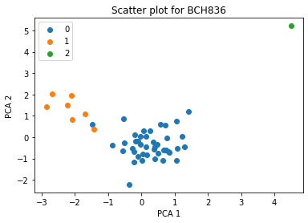
Step3 : Clustering the InferCNV output expression matrix ( Hierarchical Clustering-ward linkage)
Notes:
## show the cut part , scatter plot of the clusters

Slide 18
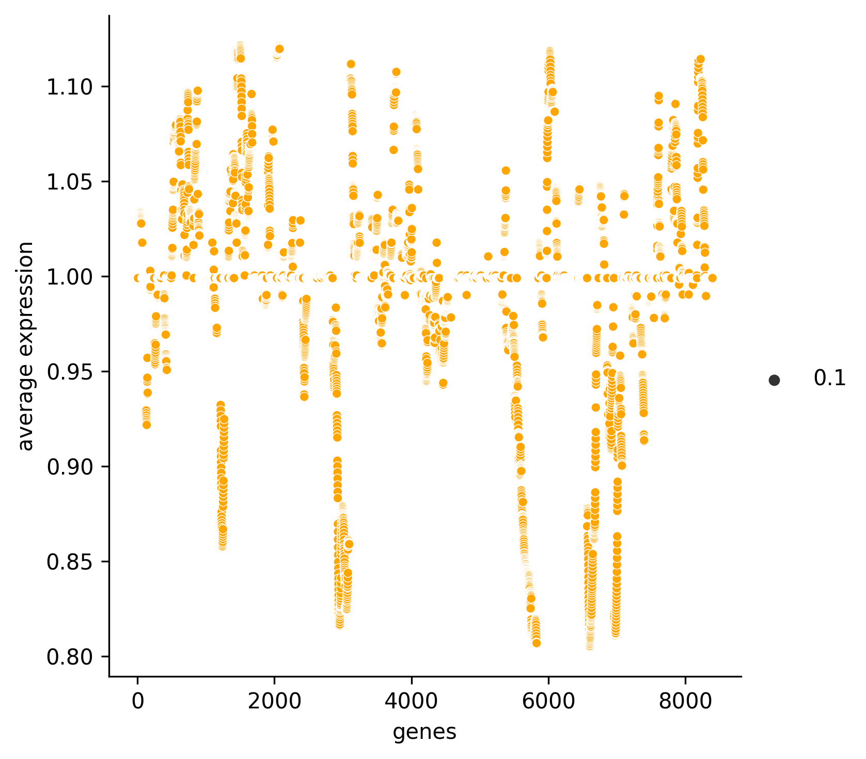
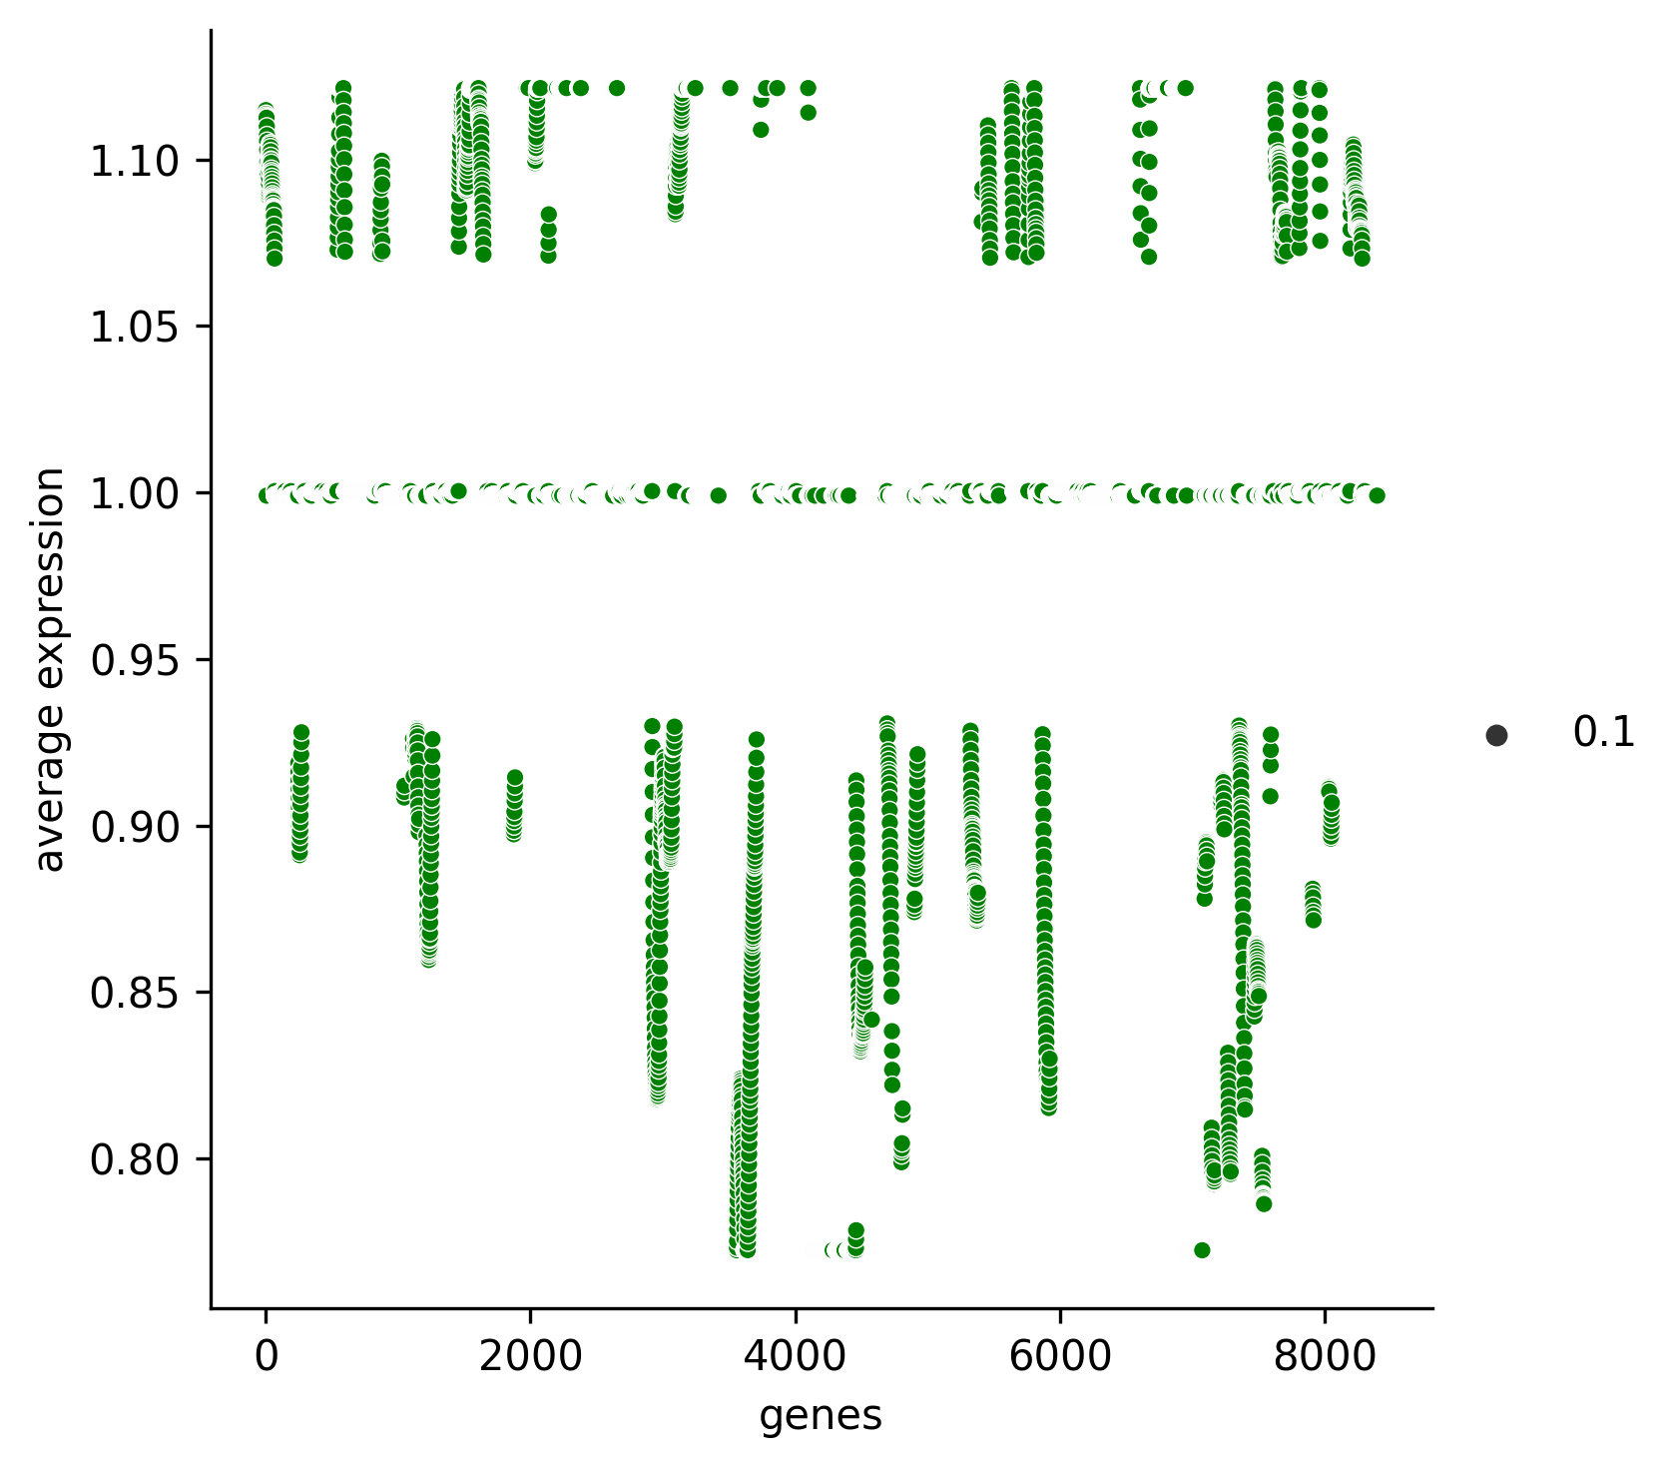
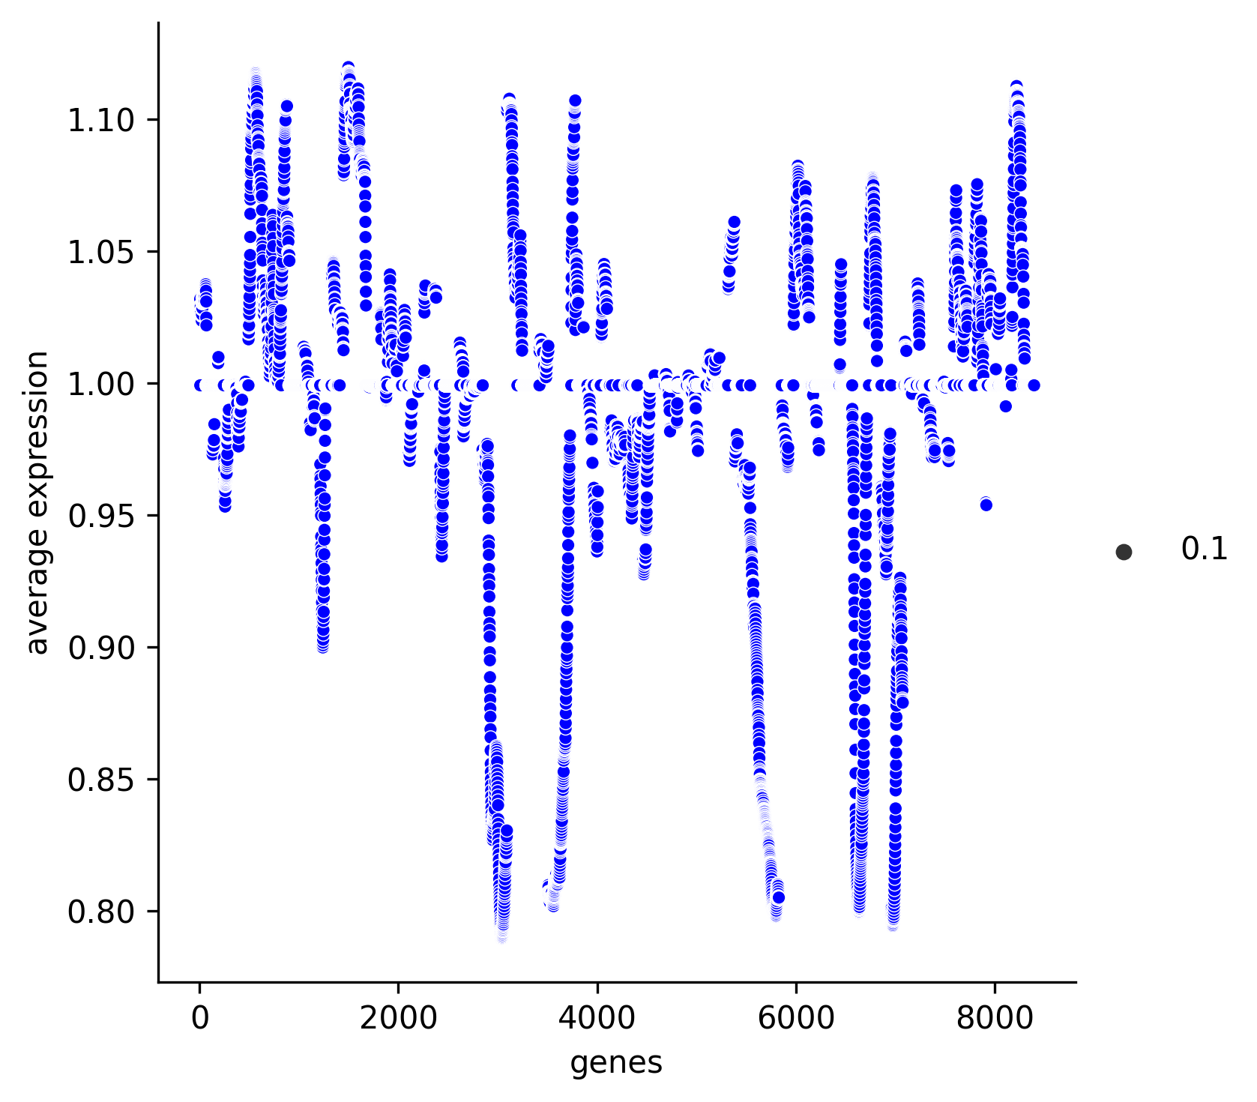
Step 4. For each cluster, generate the average of the expression
Cluster 0 Cluster 1 Cluster 2
Notes:
## this will create signal corresponding to the

Slide 19
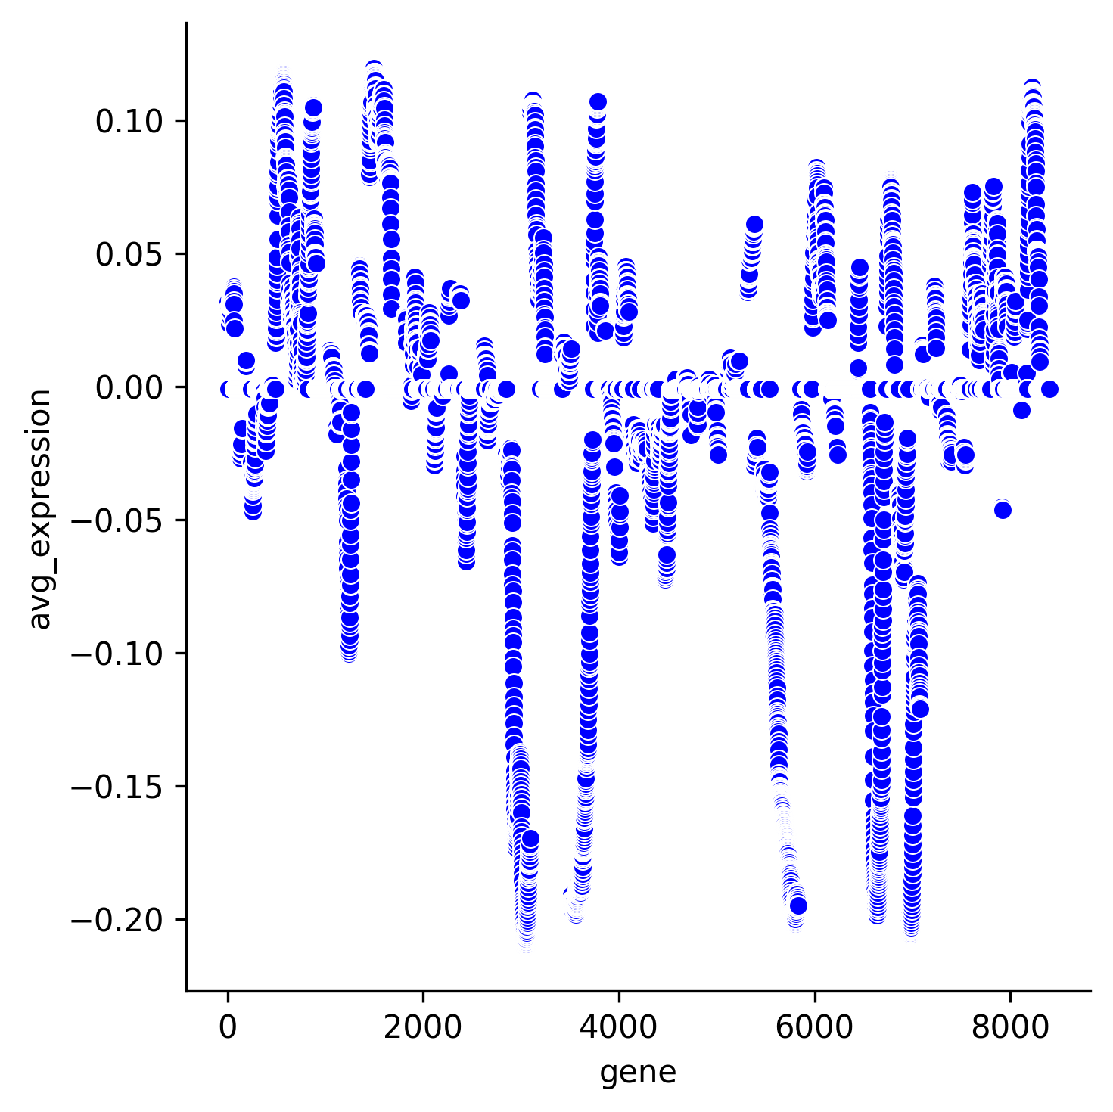
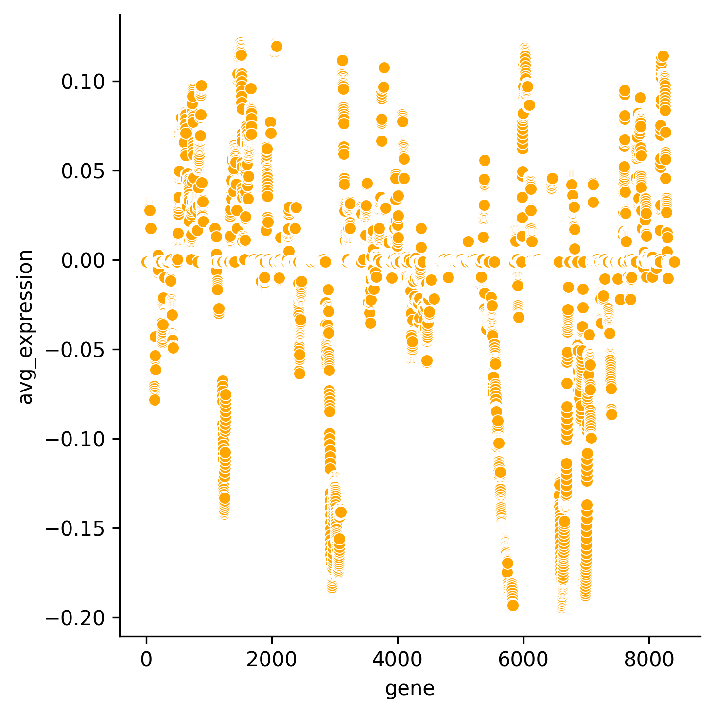
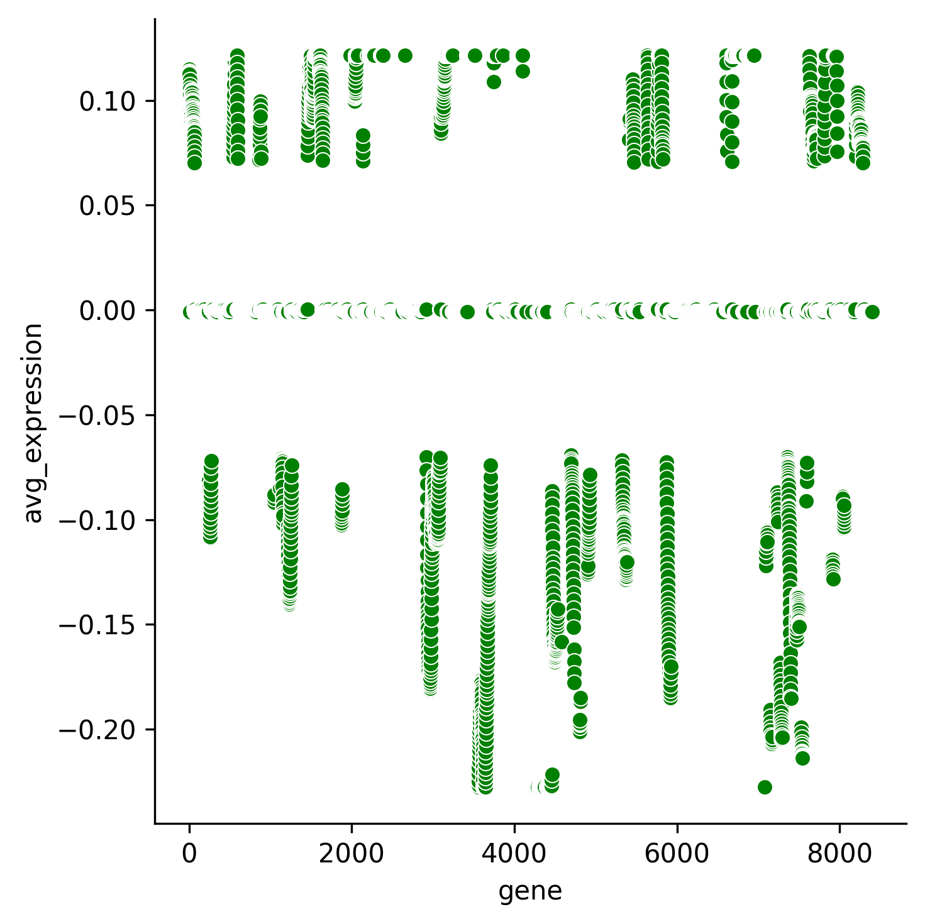
Step 5. Shifting mean to the origin
Shift the mean of average expression of all the cluster to 0.Then expression value >0 will be having copy number gain and if <0 will be having copy number loss
Cluster 0 Cluster 1 Cluster 2
Notes:
one cluster average expression , mean shifted wo wala diagram bhi , show the original distribution from the heatmap

Slide 20
Step 6. nC2 Combinations , n= number of clusters
Take all the possible pair combinations of the average expression of the clusters . Each combination will have signals corresponding to two clusters which will be taken as A and B.
n clusters will correspond to nC2 such combinations.

Slide 21
The Key Idea
A = 0.2 , 0 , 0, 0
B= 0.05 ,0, 0 ,0
A-B = 0.15 , 0 , 0
A-B <= A (with same direction that of A) ; valid . This implies B -> A (A has more similar kind of mutation compared to B )
B-A = -0.15, 0, 0, 0 (no such direction exist for A nor B) ;invalid
If different kind of mutation present in two signals at same chromosome position , we can say that they are not directly related. It’s not possible to establish any direct relation in that case.

Slide 22
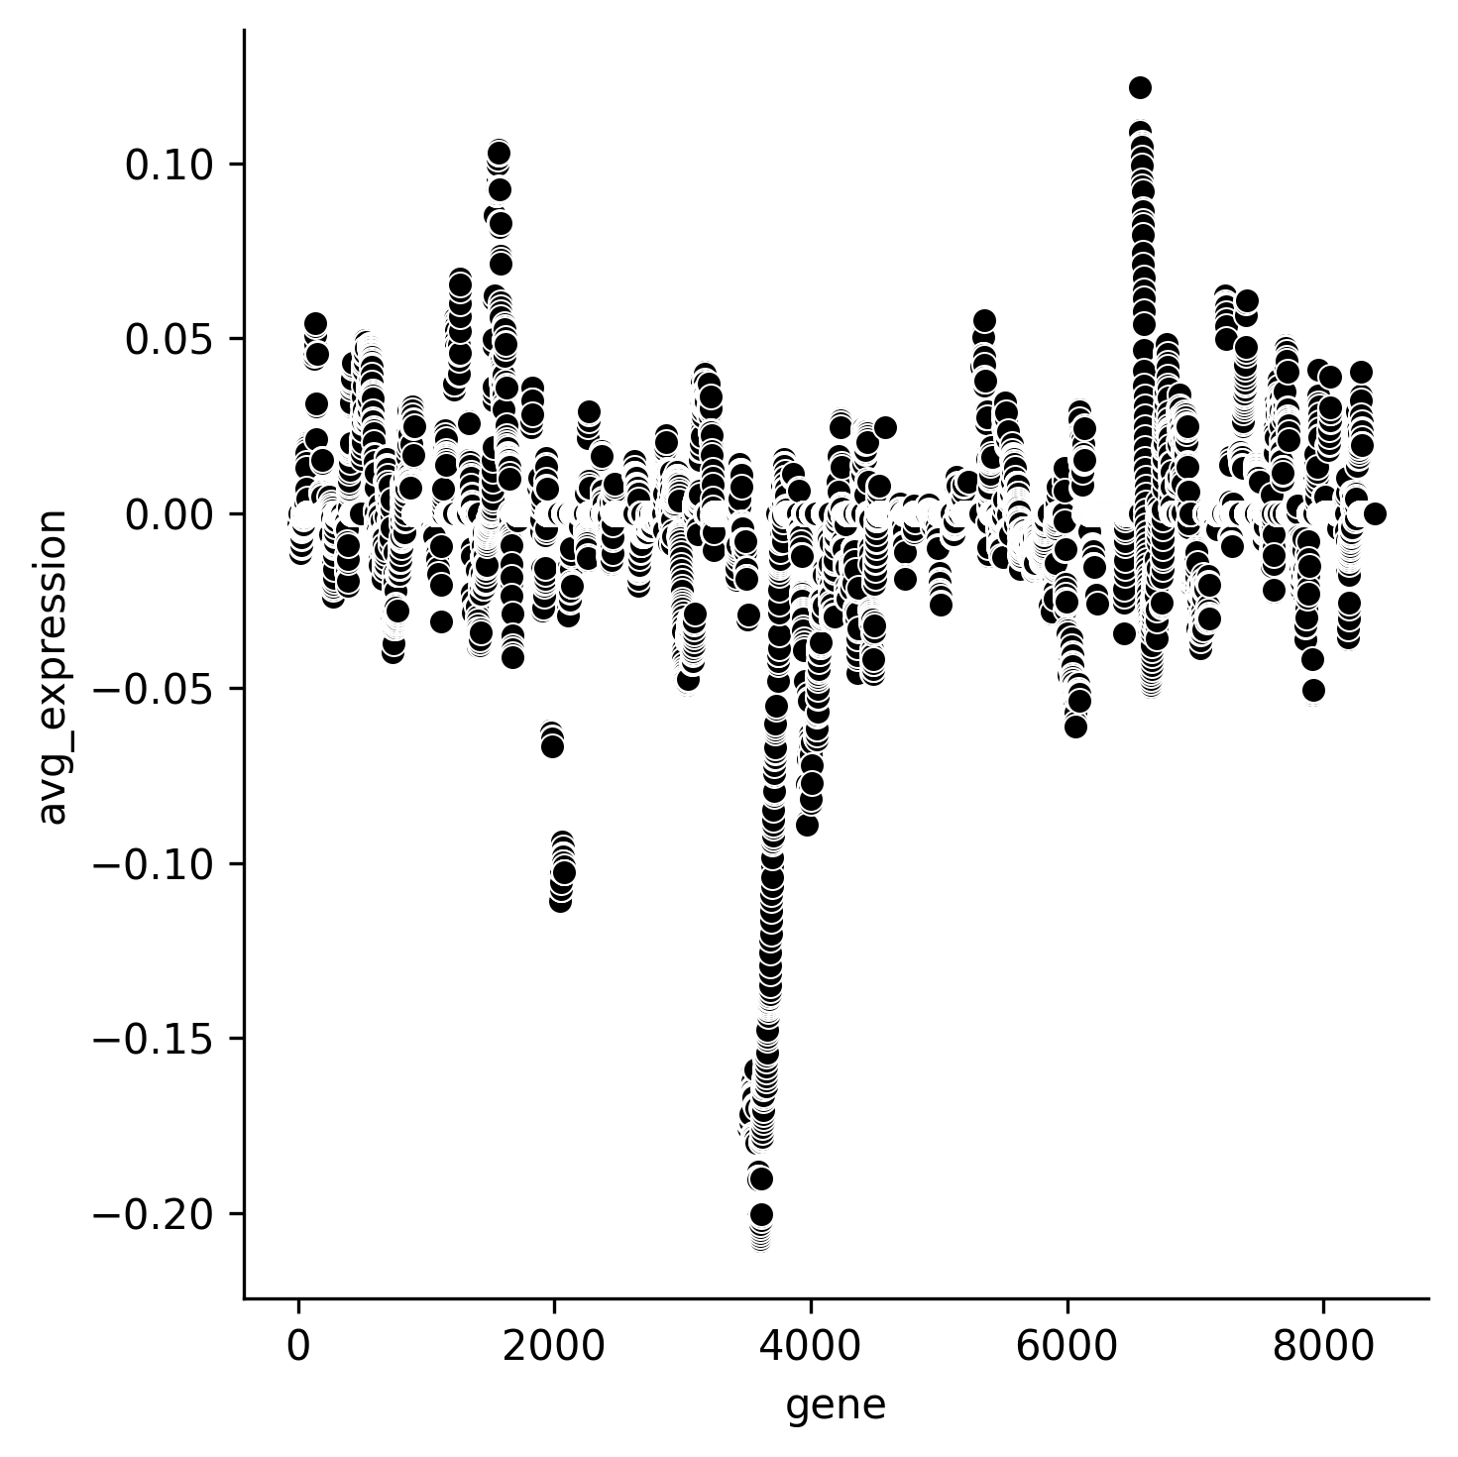
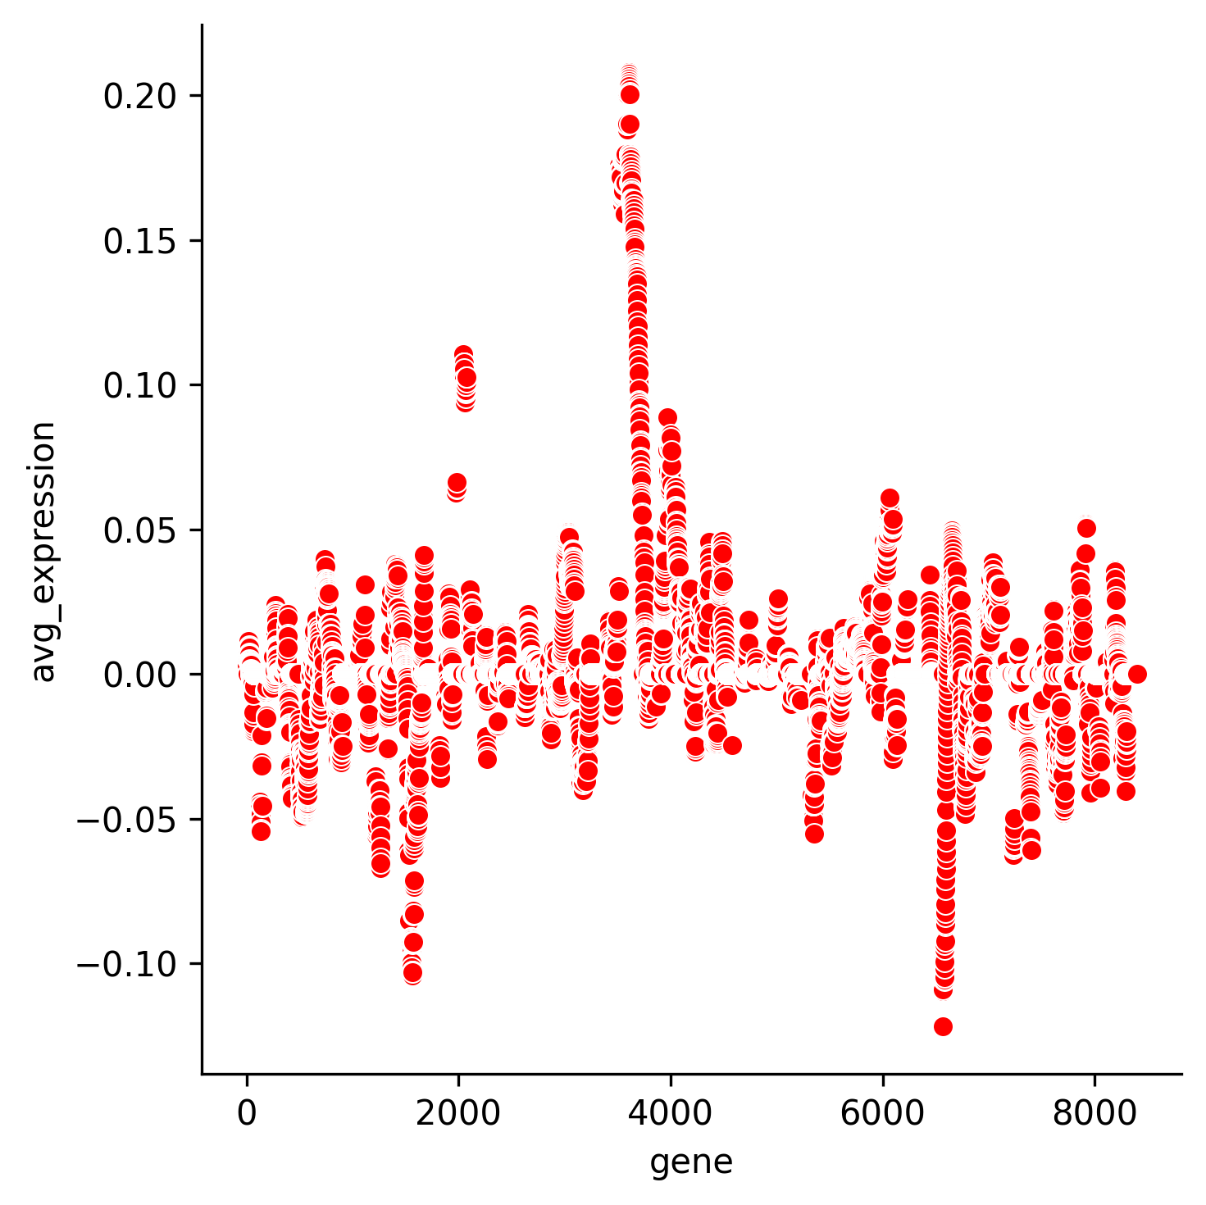
Step 7. Generate both A-B and B-A
For each combination , generate A-B and B-A both. For ex: A= cluster 0 , B= cluster 1
A-B B-A
Notes:
## add the graph for both these

Slide 23
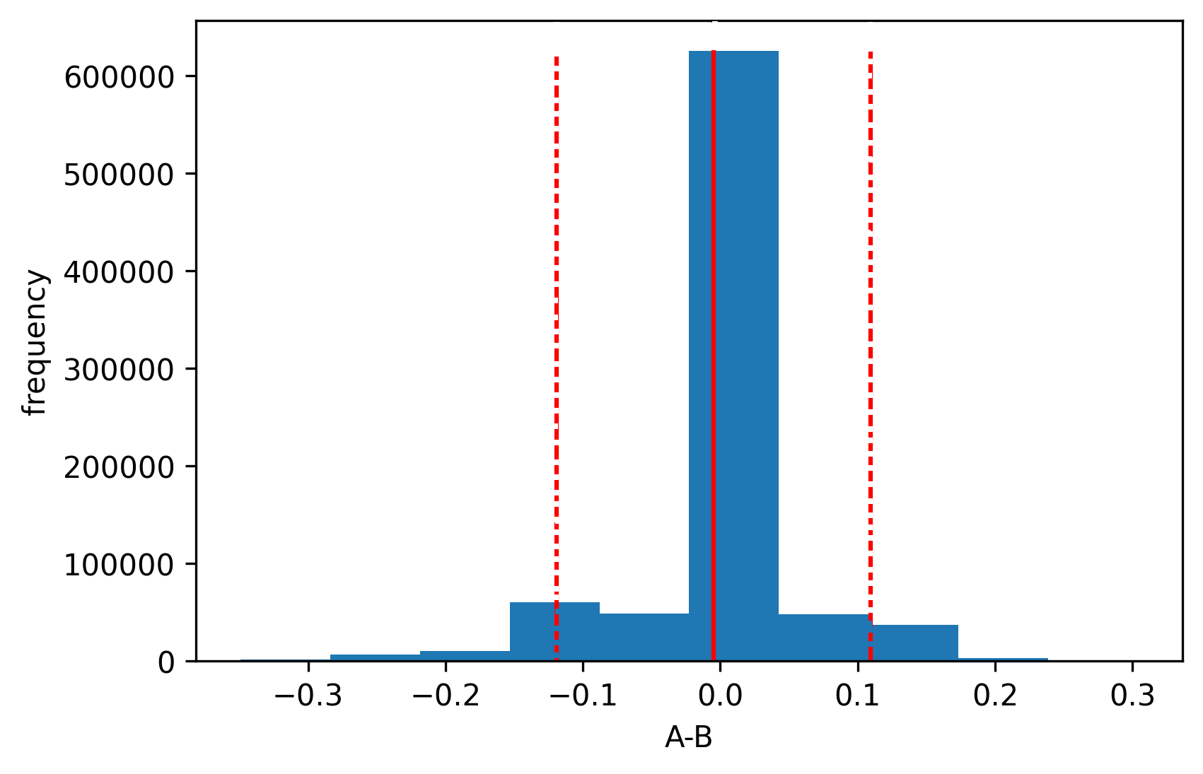
Step 8. Noise filter(significant signal difference)
Using Monte Carlo Randomization:
95 % Confidence interval:
[-0.11, 0.10]
(this is removed as noise)
Notes:
## talk about Monte Carlo Randomization ## talk about the signal significant signal difference : plot and extreme 5 percent and find the confidence interval.

Slide 24
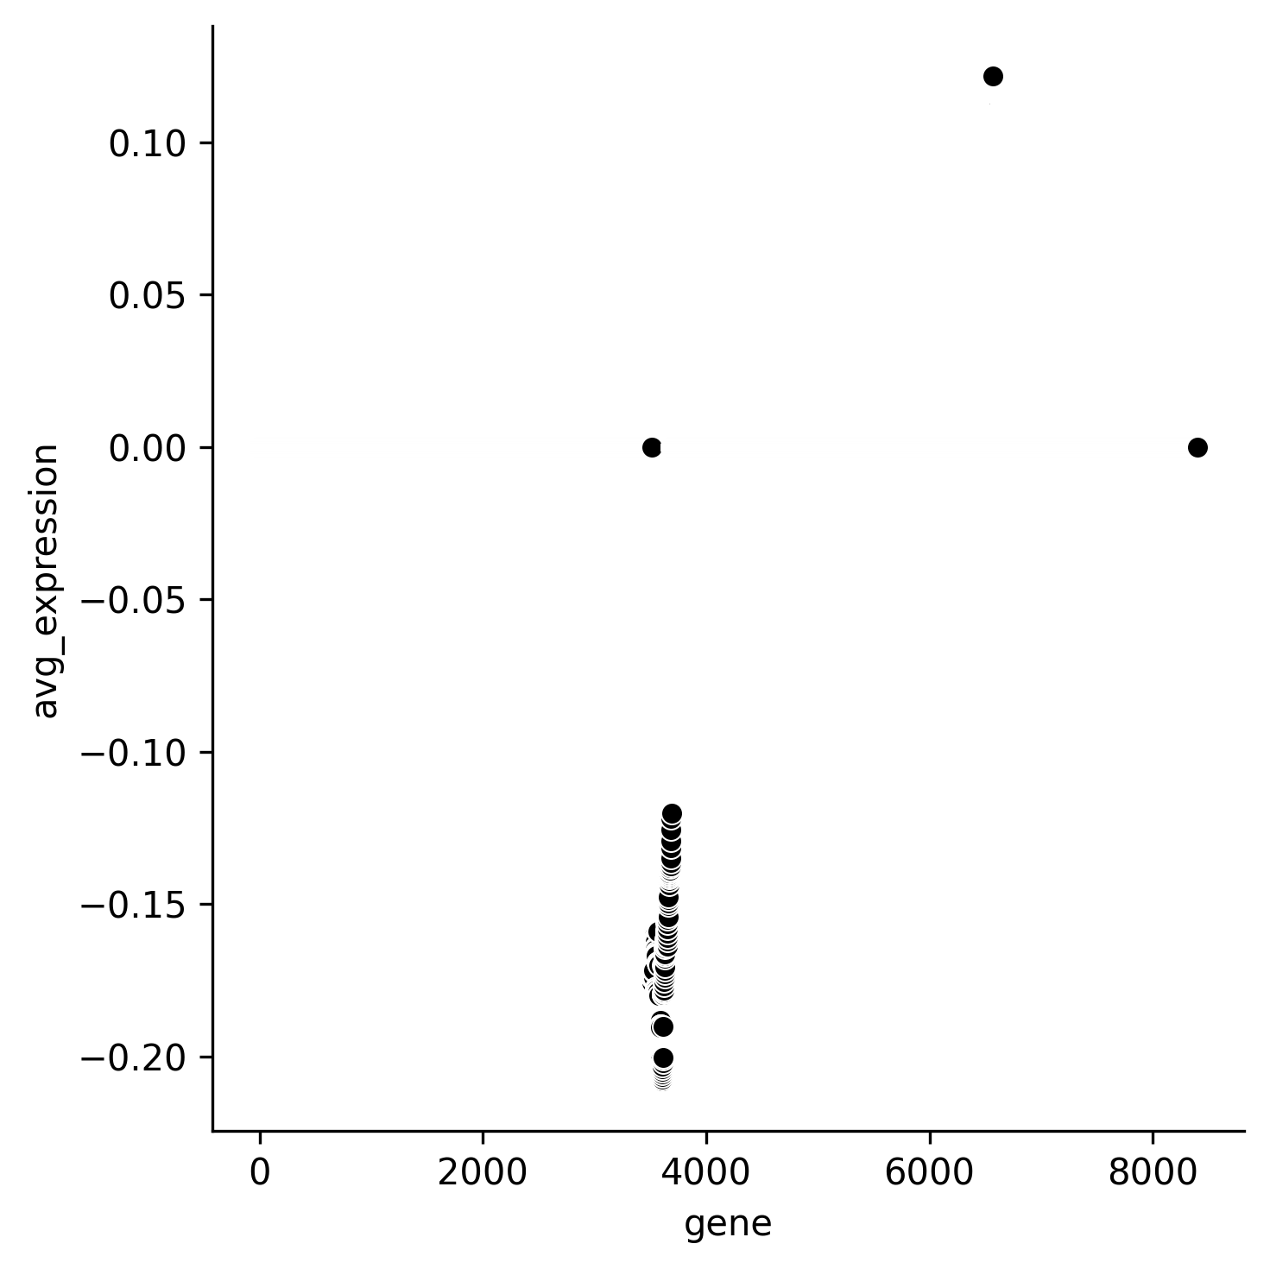
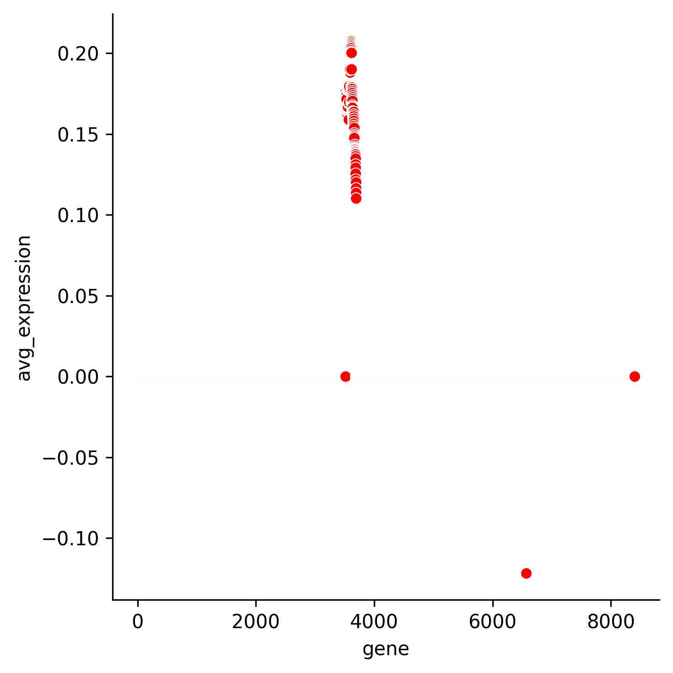
Step 8.Noise filter continued..
A-B B-A

Slide 25
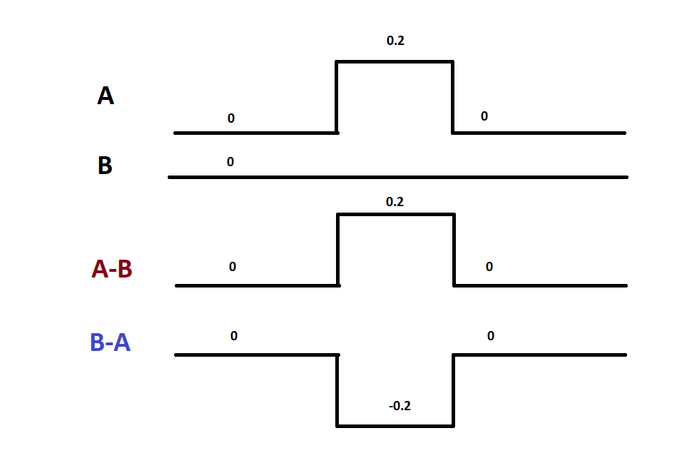
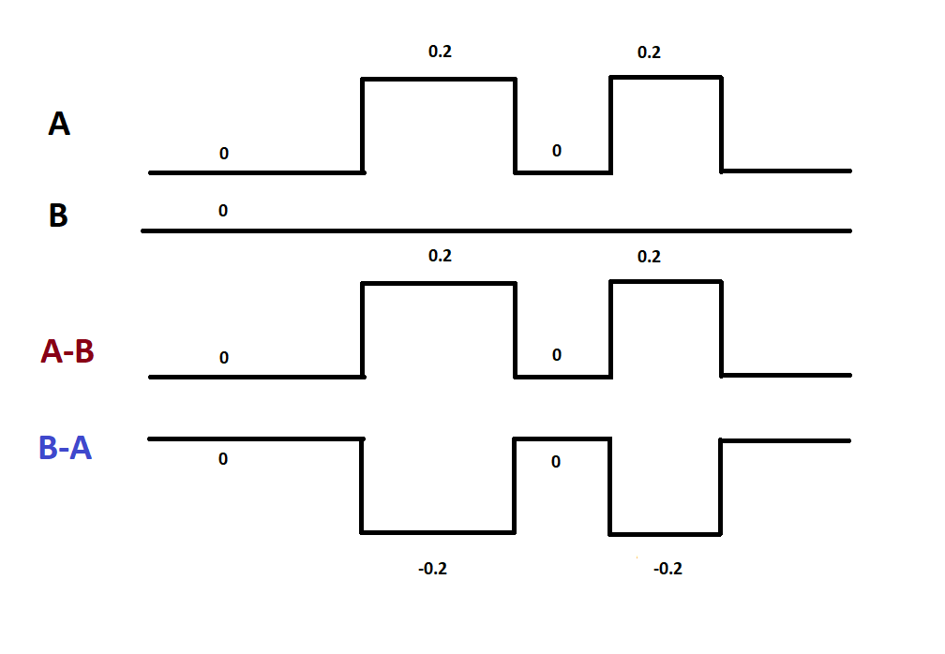
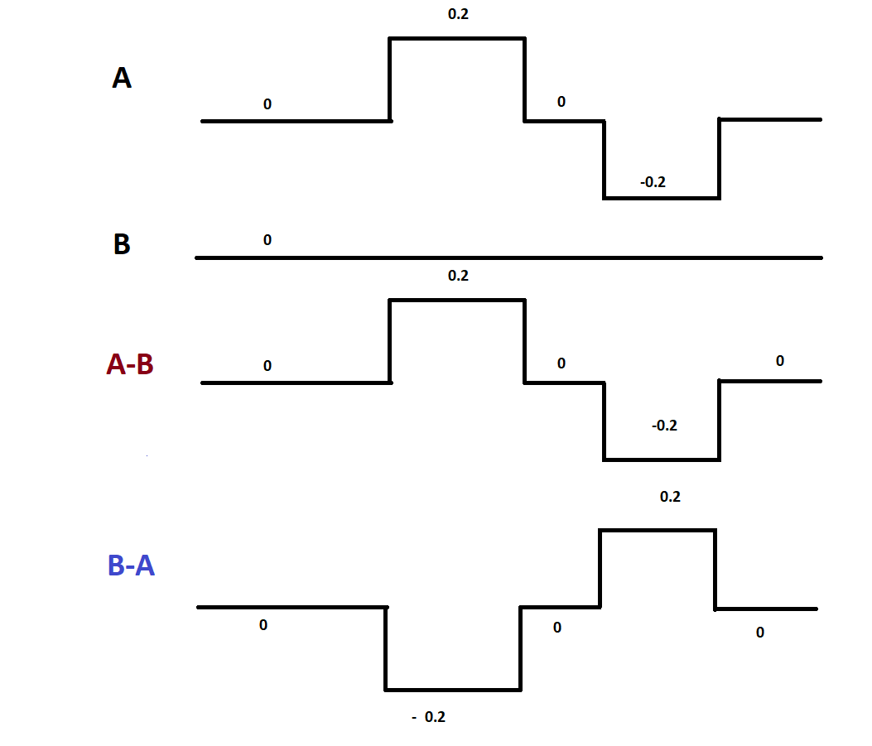
Sample Cases- Understanding the algorithm
B->A B->A B->A
| Copy Number Gain in A | Copy Number Gain in A at more than one position | CN gain at one chromosome position ,loss at other
| No mutation in B | No mutation in B | No mutation in B
Notes:
For better understanding

Slide 26
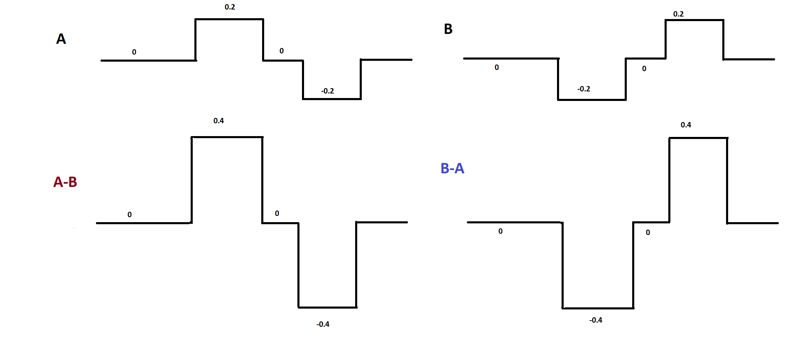
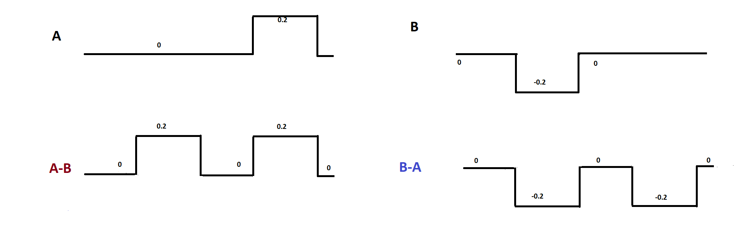
Sample Cases- continued
A and B are not related A and B are not related
A: CN gain at chr 1 , CN loss at chr 3 A: normal at chr1 , CN gain at chr3
B: CN loss at chr 1, CN gain at chr 3 B: CN loss at chr1, normal at chr3

Slide 27
Step 9: Constructing Phylogeny
For difference_signal in [A-B , B-A]
Count the number of spikes
Every spike should have direction similar to that of any parent
The absolute magnitude of the spike of difference signal should be less or equal to the parent signal.
If the condition hold true for every spikes in the difference_signal ,then difference_signal is valid otherwise ,no direct relation.
if A-B is valid , relation will be B->A
else if B-A is valid ,relation will be A->B

Slide 28
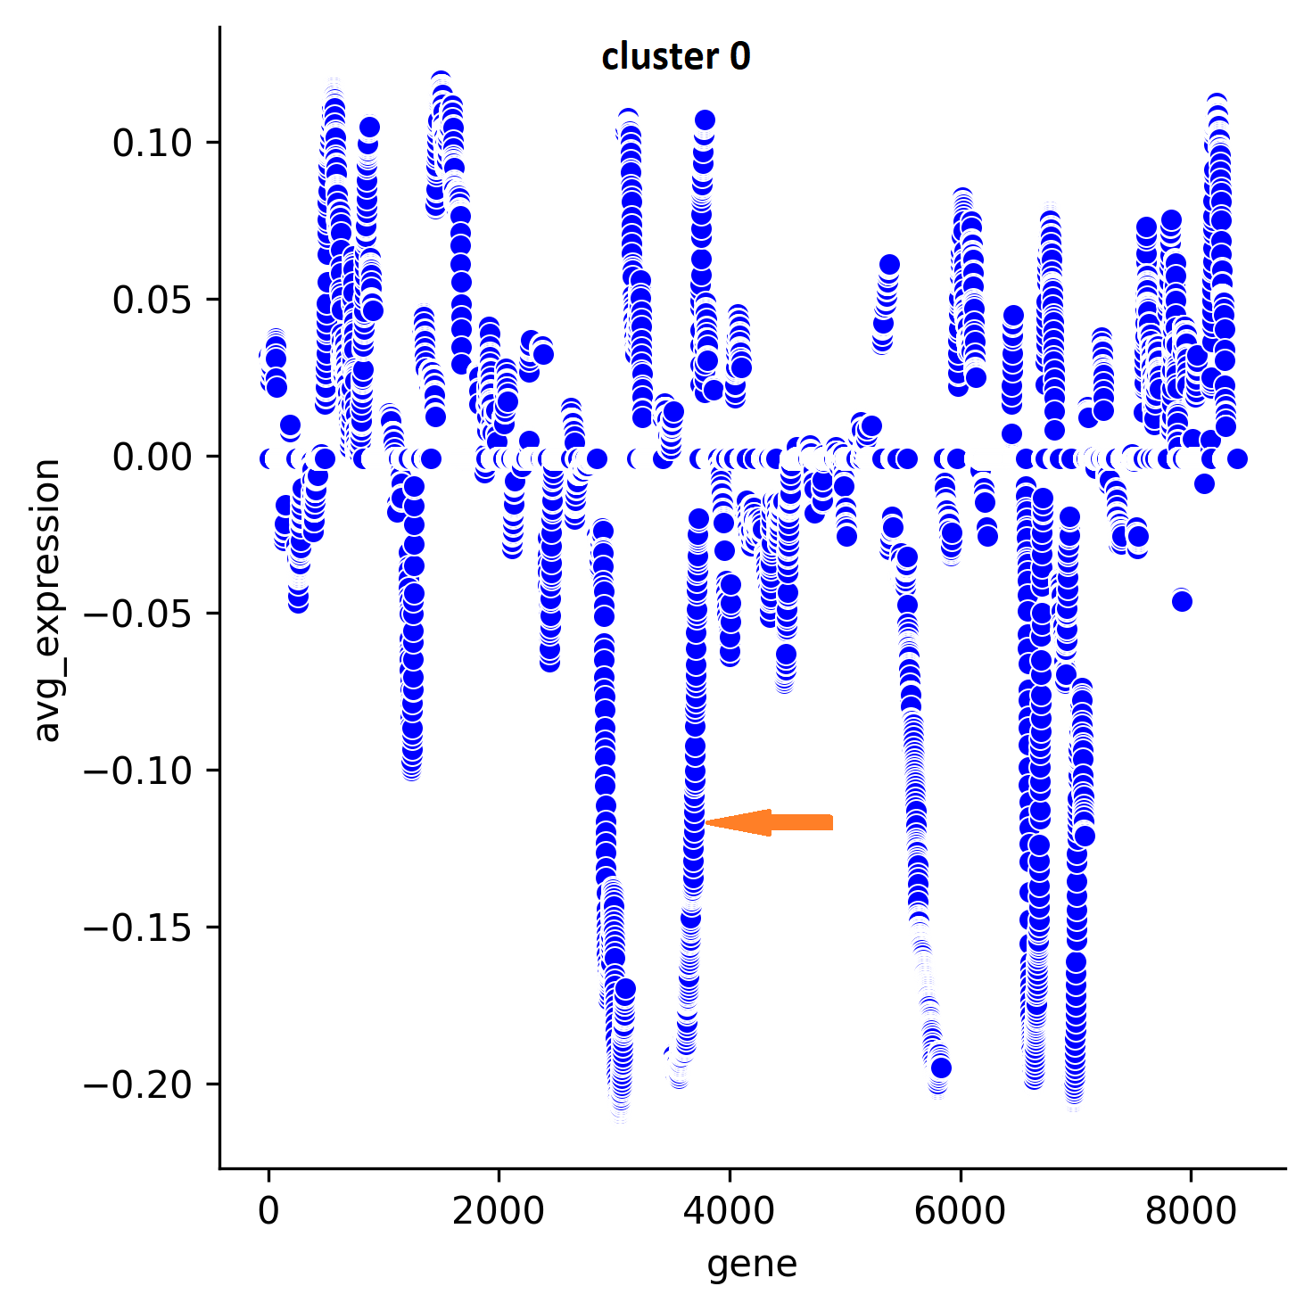
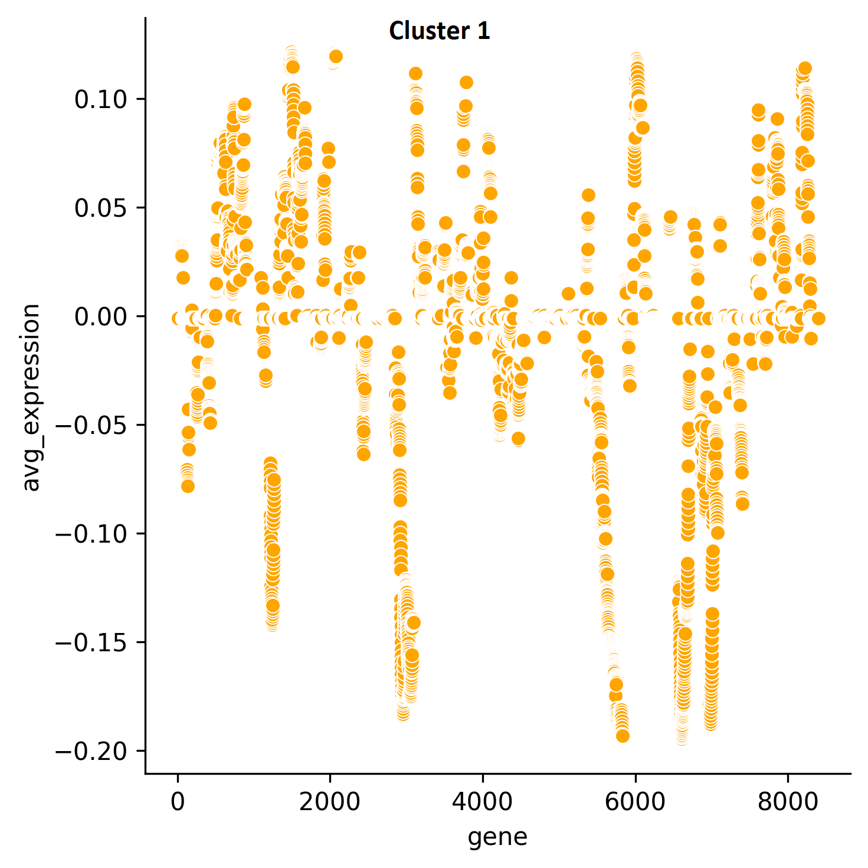
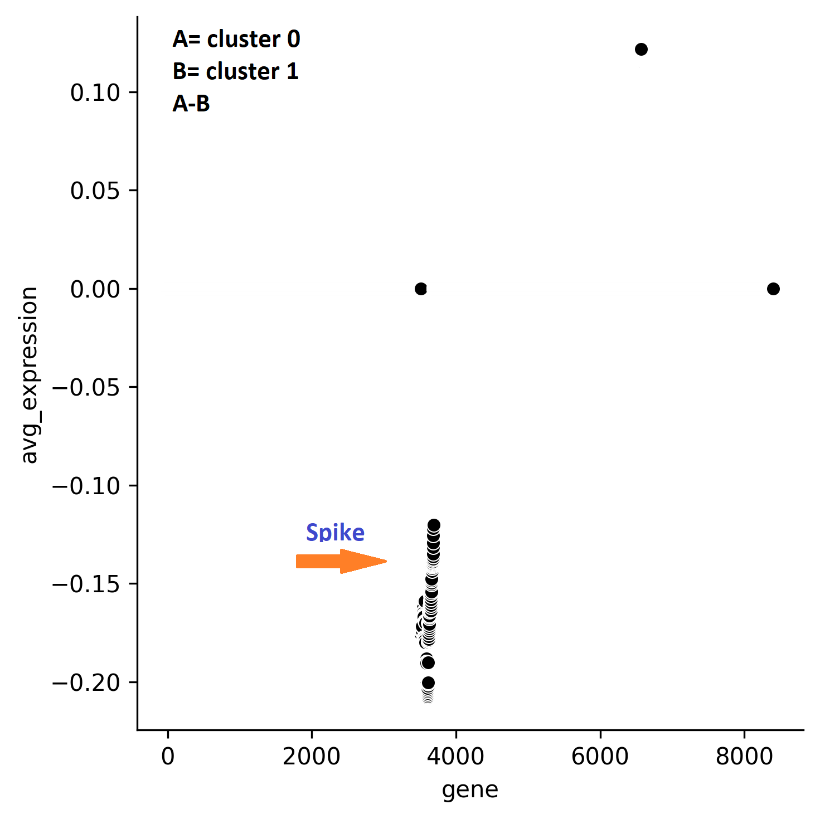
For BCH836: taking cluster_0 and cluster_1
A-B is valid , its spike coincides with the spike in A i.e cluster 0 , also magnitude is less than the parent.
Notes:
## add the spikes count and all that stuff for particular tumor here

Slide 29
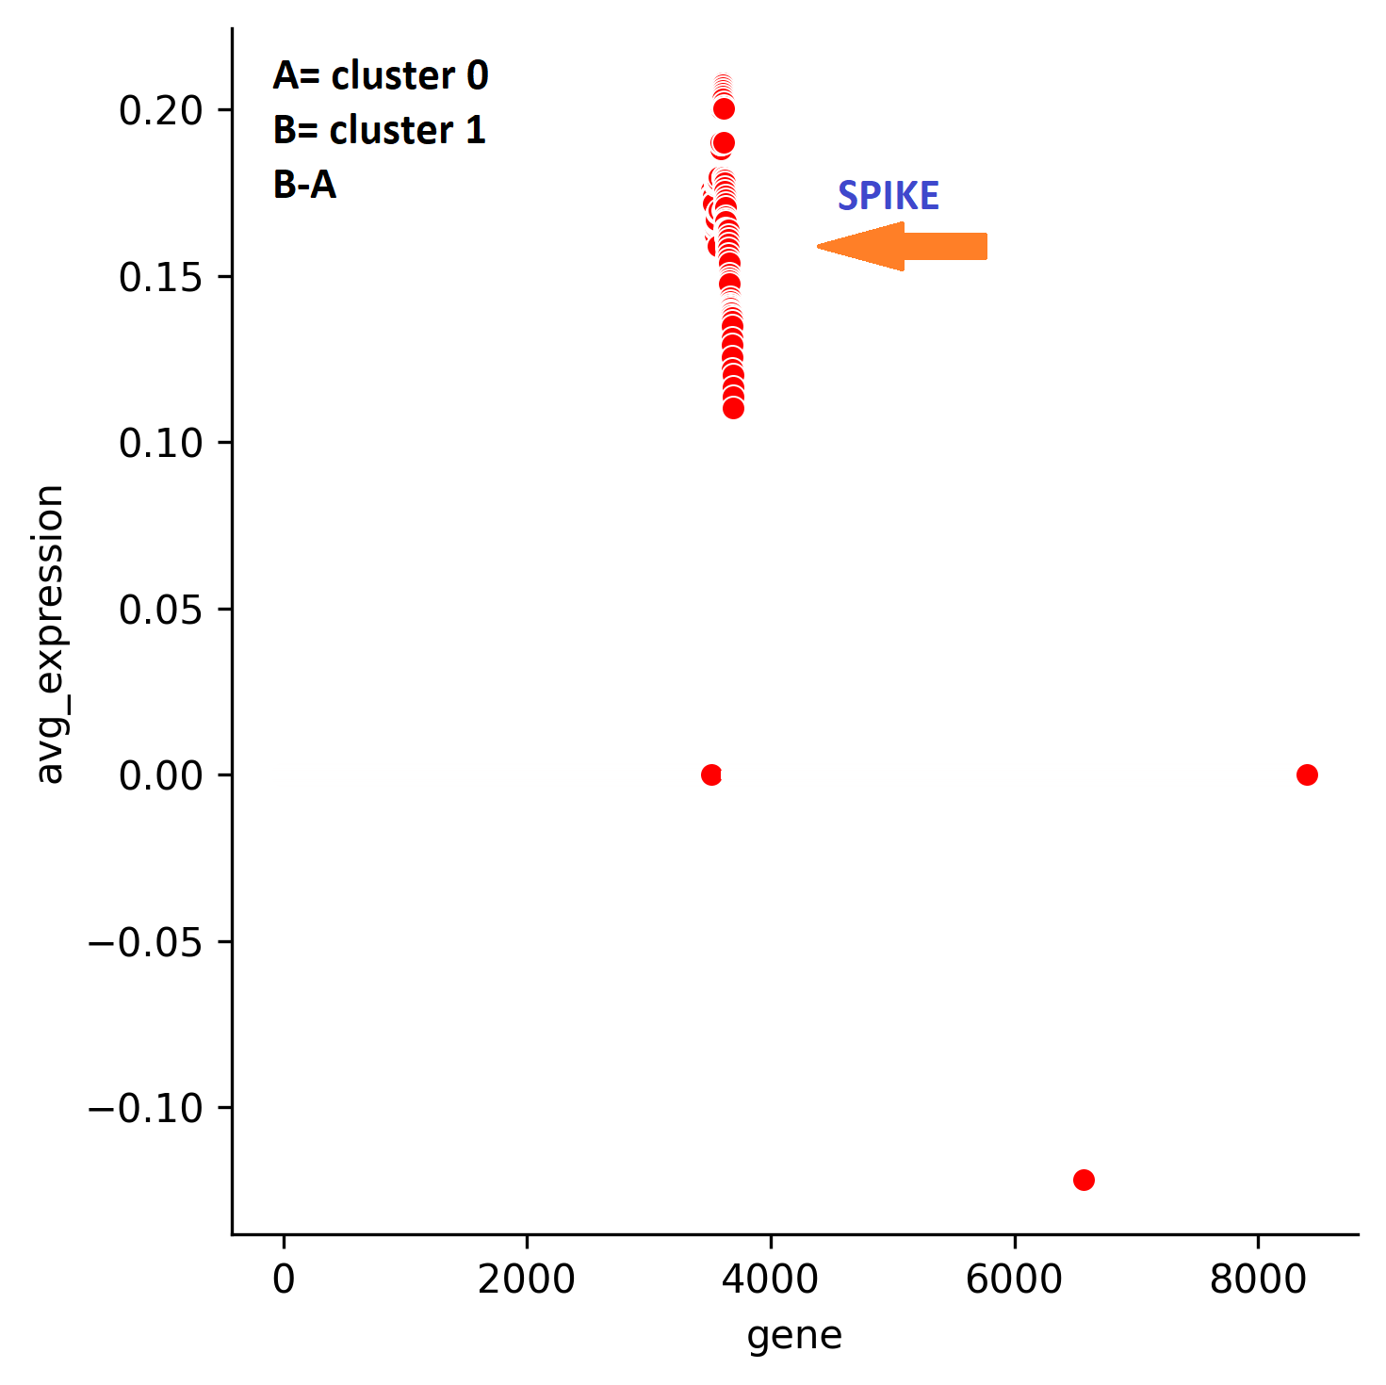
For BCH836: taking cluster_0 and cluster_1
all the spikes should coincide with any parent and absolute value should be less than the parent . This doesn’t hold true in B-A. B-A is invalid.

Slide 30
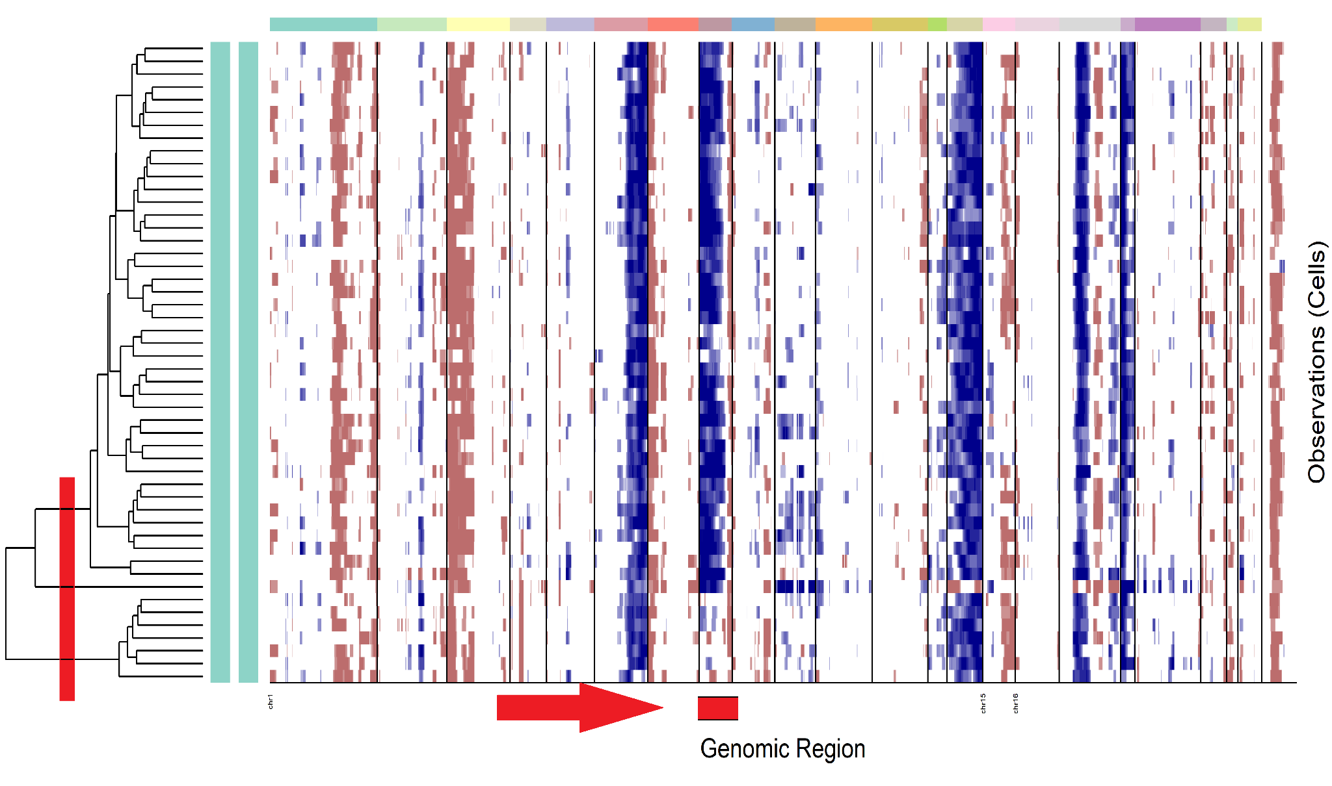
Relation between cluster 0 and cluster 1
Since A-B is valid , clonal relation = B->A
Or cluster 1 -> cluster 0
Similarly it was resulted that cluster 2 doesn’t has any relation with either cluster 0 nor cluster 1
1 2 0

Slide 31
Step 10. Spanning Tree
Obtain the relationship between all the pair of clusters average expression.
Remove transitive relationships.
Call Minimum Spanning Tree for constructing phylogeny.
Notes:
Minimum spanning tree , and removing any transitive dependencies.

Slide 32
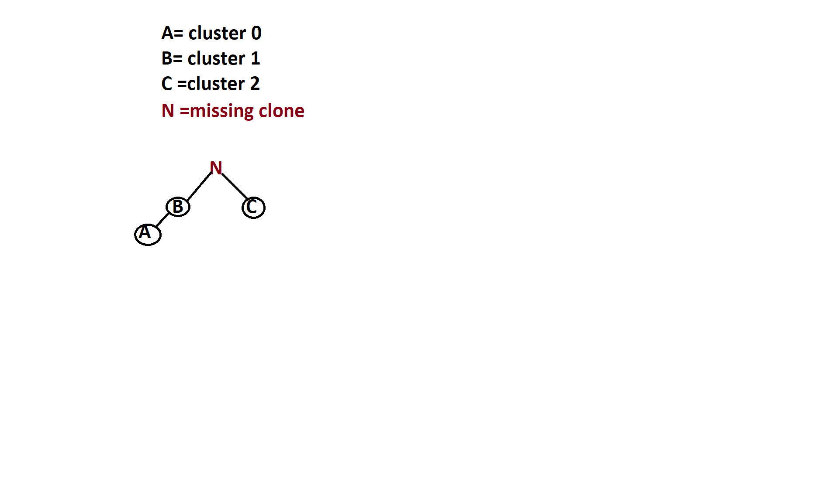
Result : For BCH836

Slide 33
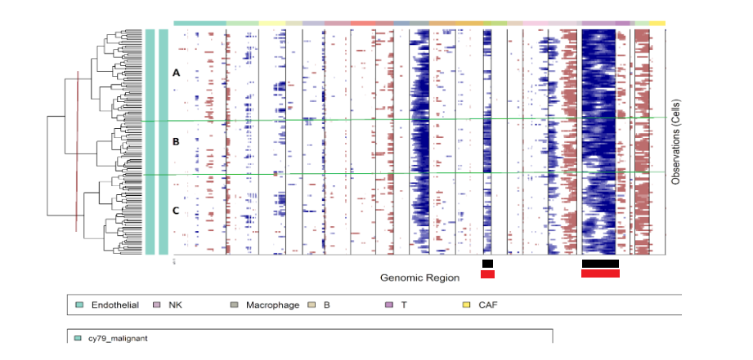
Result : For Tumor name -> Melanoma ,Patient-CY79
Clonal Phylogeny:
C->A->B

Slide 34
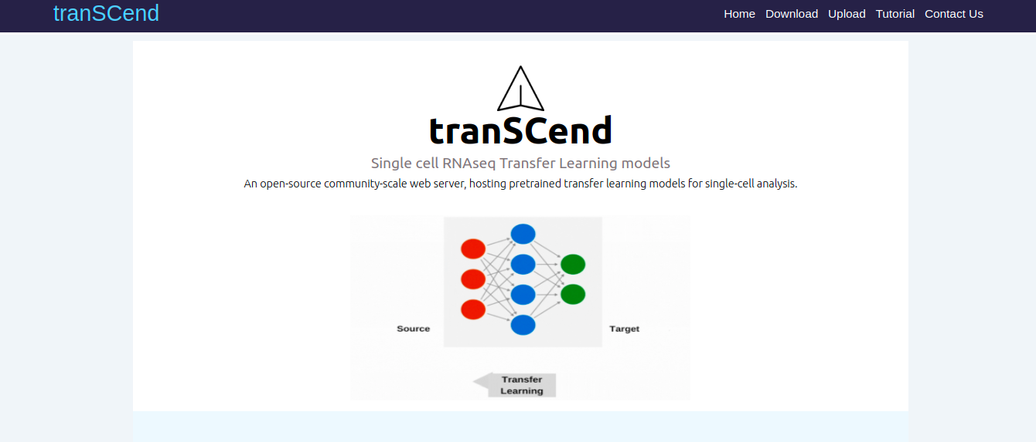
Part2. tranSCend : deployed at- http://transcend.senguptalab.iiitd.edu.in/
A platform for Transfer Learning Based single cell analysis, hosting pre-trained models.

Slide 35
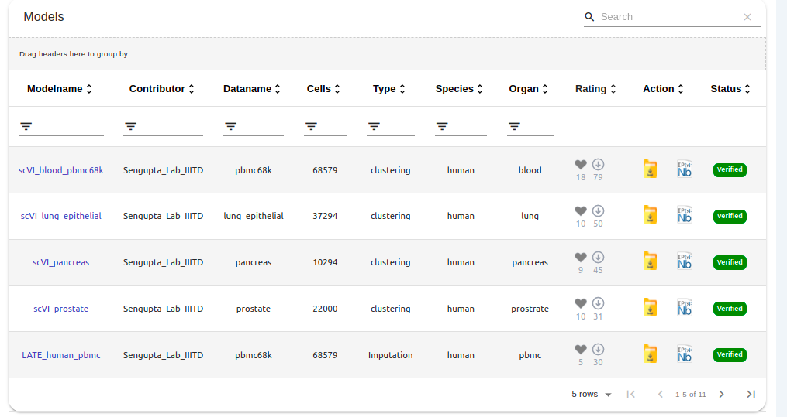
Model Browser: Hub for pre-trained models

Slide 36
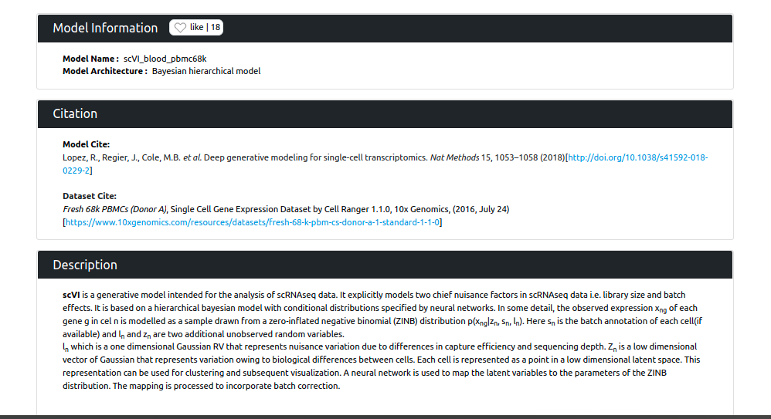
Model Card: Everything about the hosted models

Slide 37
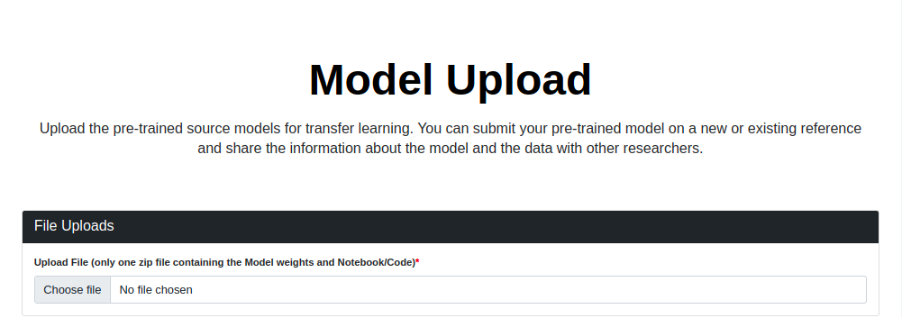
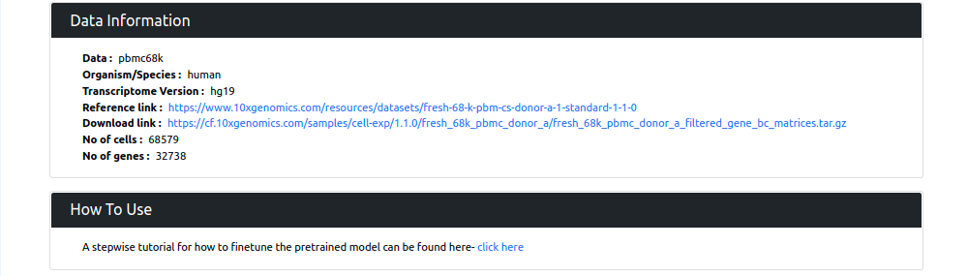
Model Upload: Upload your state-of-art model

Slide 38
Acknowledgement
Sincere regards to Prof. Debarka Sengupta for his guidance.
Ph.D. scholar, Namrata Bhattacharya and Sarita Poonia for their valuable mentorship.
My teammates Dinesh Joshi and Rishab Munjal , tranSCend was possible because of them.
Department of Computational Biology and IT administrators at IIIT Delhi for providing me with the necessary resources
Thank my family and friends for providing much-needed support and cheering me up during my whole thesis.

Slide 39
Thank You !
Any Questions ?
Name- Kiran Sethi
Roll no-MT20211
Branch-CB

